Slide 1
COVID Hackathon

Slide 2
Contents
Submission Name
Submission Track
Short Description
Long Description
Solution Roadmap
Github/Code repository Link
Demo Video Link
IBM Cloud Services or IBM Systems used in solution
Team Members and Mail id

Slide 3
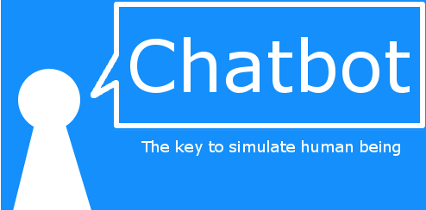
Submission Name
SEVA

Slide 4
Submission Track
Covid-19

Slide 5
Short Description
This services can be accessed by a web portal or a mobile app.
It opens a Chatbot which provides 4 types of emergency services.

Slide 6
Long Description
Chatbot, a computer program that simulates human conversation or chat through artificial intelligence.
We are integrating four services to chatbot which helps during pandemic. They are
Food Service
Medical Support
Contribution
Domestic Violence
User can get assistance from web/mobile applications through chat with the help of IBM Watson Assistant.

Slide 7
Long Description
Food Service
This is a platform which connects different communities of people who are interested in supplying food for those who need food or are unable to cook food. This can be done in the following way.
Users can request for food by placing an order or by contacting the POCs of community Kitchens.

Slide 8
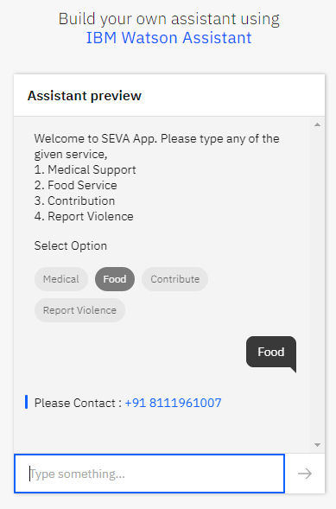
Long Description
Food Service

Slide 9
Long Description
Medical Support
A platform where people can request for medical support (like saline, basic test like blood pressure, heart beat measure) that can solve their basic medical needs.
People can also place an order or by contacting the POCs of medical support team.

Slide 10
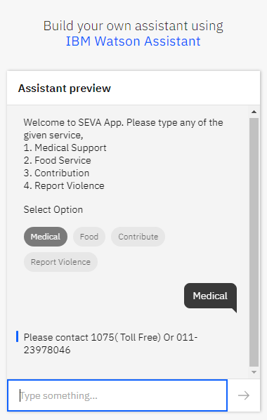
Long Description
Medical Support

Slide 11
Long Description
Contribution
A platform that can connect people who are willing to supply food , medical guidance and equipment to users who are in need.
Users can contribute the funds to Government enabled relief funds using the link.

Slide 12
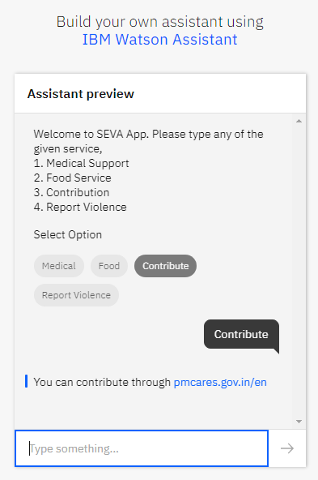
Long Description
Contribution

Slide 13
Long Description
Domestic Violence
This is a platform where women/men can report the domestic violence against them to police.
People who experience domestic violence during lockdown period can register their complaint

Slide 14
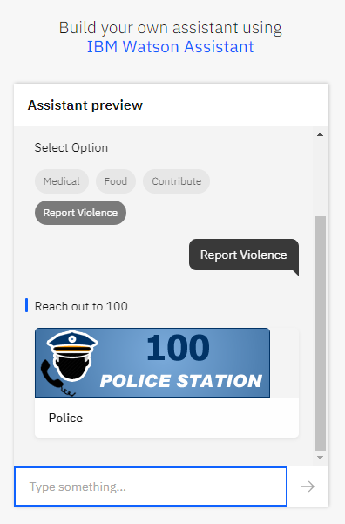
Long Description
Domestic Violence

Slide 15
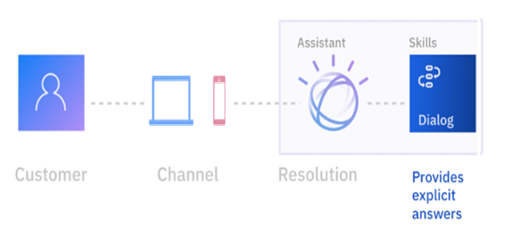
Solution RoadMap

Slide 16
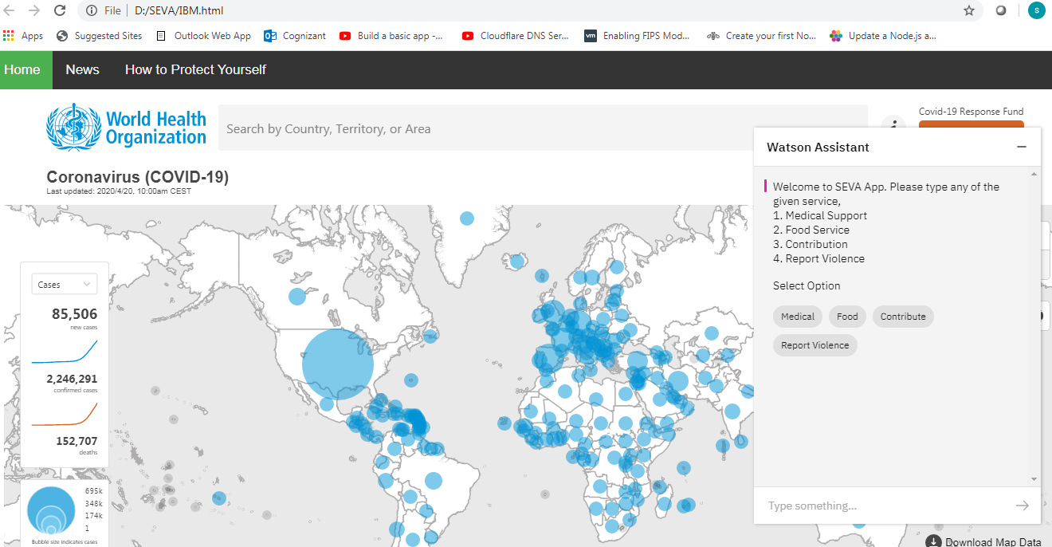
GitHub/Code Repository Link
Web Portal
Home.html

Slide 17
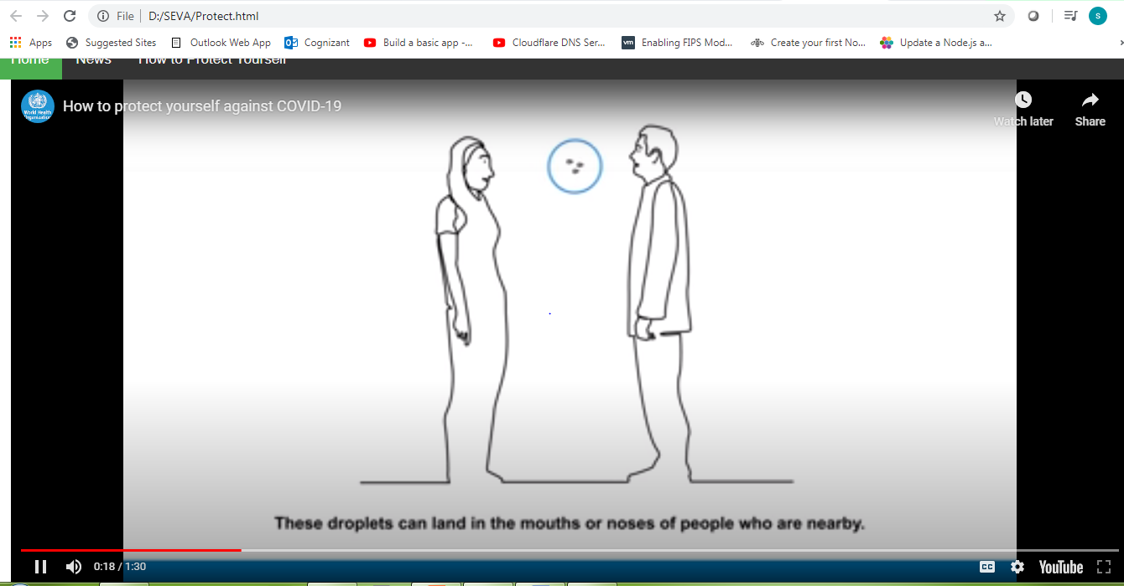
GitHub/Code Repository Link
Web Portal
Protect.html

Slide 18
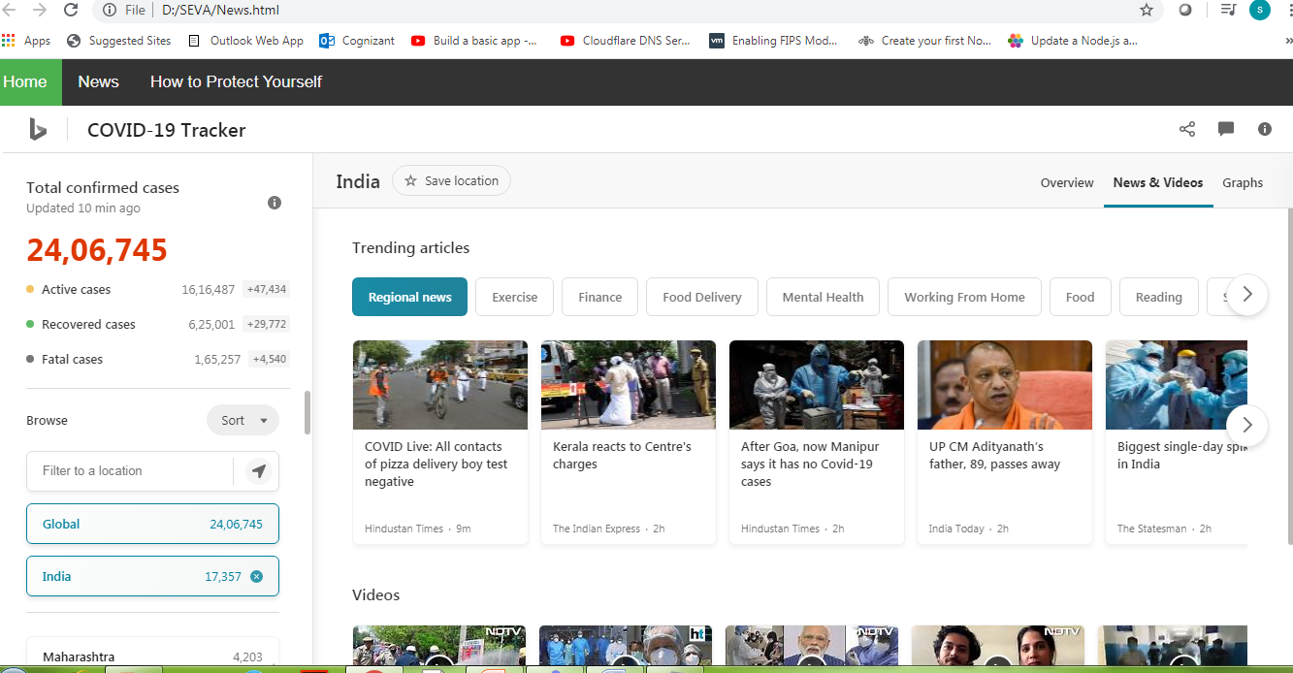
GitHub/Code Repository Link
Web Portal
News.html.

Slide 19
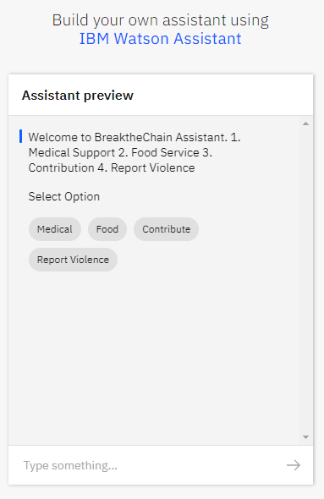
GitHub/Code Repository Link
Mobile app – https://integrations.eu-gb.assistant.watson.cloud.ibm.com/web/public/6f19a779-205f-4ea2-a501-b857e77a8fcd

Slide 20
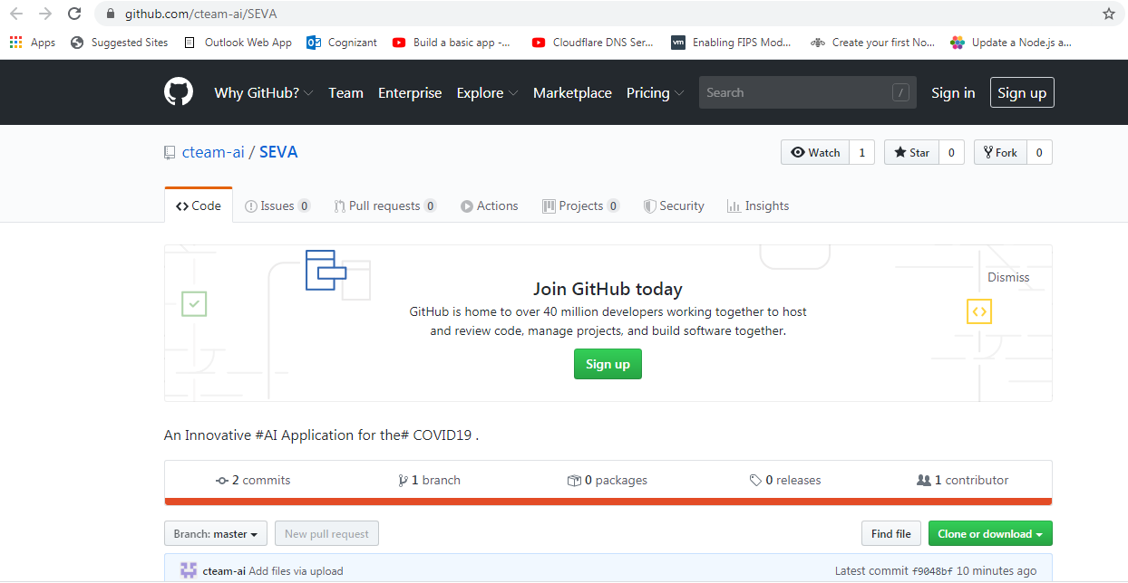
GitHub/Code Repository Link
https://github.com/cteam-ai/SEVA
GitHub link -

Slide 21
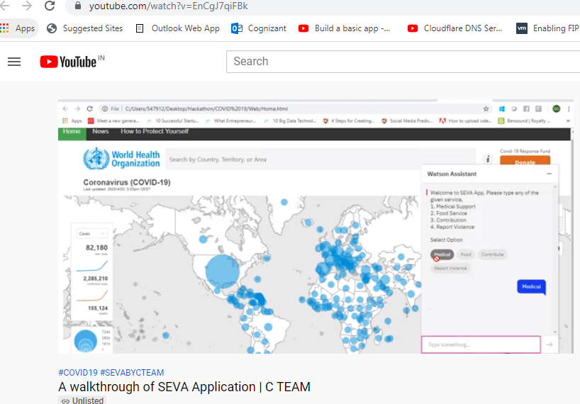
Demo Video Link
https://www.youtube.com/watch?v=EnCgJ7qiFBk
Link -

Slide 22
List of IBM Cloud Services or IBM Systems used in Solution
IBM Watson Assistant
IBM Watson Assistant is a white label cloud service that allows enterprise-level software developers to embed an artificial intelligence (AI) virtual assistant (VA) in the software they are developing.

Slide 23
Team Members and Mail-Id
Mithun Ghosh - Mithun.Ghosh2@cognizant.com
Sooryaprakash S - Sooryaprakash.S@cognizant.com
Neethu V Nair - NeethuV.Nair@cognizant.com
Naga Durga Sridevi Allam - NagaDurgaSridevi.Allam@cognizant.com

Slide 24
Thank You

